Slide 1
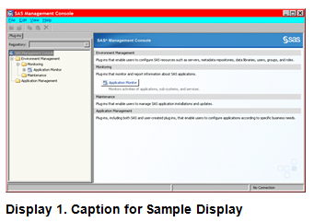
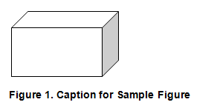
MWSUG 2016 Sample Paper Author 1 Name, ABC Corporation; Author 2 Name, DEF Corporation
Paper can be broken into Main Topics, sub-topics and sub-sub-topics as necessary
Each topic level will use a specific heading style
Body of paper uses the PaperBody Style
Follow the Submission Guidelines and use the templates
Incorporate proper use of bullet or numbers when displaying a list of items
Don’t bury SAS code
Add captions to objects
The source code should be introduced with a sentence that ends with a colon:
data _null_;
method init();
dcl varchar(16) str;
str = 'Hello World!';
put str;
end;
enddata;
run;
quit;
How to add captions to objects

