Slide 1
Purrfectly Fabulous Feline Functions
Louise S. Hadden, Abt Associates Inc.
Introduction
Introduction
Do the following snippets of SAS® code look familiar?
length stcounty $ 5 citystzip $ 60;
stcounty=trim(left(put(state,z2.)))||
trim(left(put(county,z3.)));
citystzip=trim(left(city))||',
'||trim(left(statecode))||‘,
'||trim(left(zip));
Results:
stcounty=25002
citystzip=CAMBRIDGE, MA, 02138
Now there's an easier way! Leave those vertical bars behind and explore the purrfectly fabulous feline functions (and call routines).
length stcounty $ 5 citystzip $ 60;
stcounty=CATS(put(state,z2.),put(county,z3.));
citystzip=CATX(', ',city,statecode,zip);
Results:
stcounty=25002
citystzip=CAMBRIDGE, MA, 02138
Version 9 introduced four new functions (CAT, CATS, CATT, and CATX) and three new call routines (CALL CATS, CALL CATT, and CALL CATX) that replace the clunky syntax shown above, and add some enhanced capability to character string concatenation. In Version 9.2, the CATQ function was added.
CAT calls and functions are based on other SAS® functions:
TRIM/TRIMN (removes trailing blanks for a character field)
LEFT (left justifies a character field)
STRIP (a newer function that combines TRIM and LEFT functions)
BOTH CAT calls and functions run faster than the equivalent concatenation routines.
Cat Functions
Calling Cats
Examples
Litter Box
The CAT function
Conclusion
The CAT function is identical to simply using the concatenation operator ( || ) to string character literals, variables or expressions together. No leading or trailing blanks are removed from arguments.
Click Headings Above to View Content
S
63 data temp3;
64 set dd.sub2003asm ;
65 fullname=CAT(aa1a,aa1b,aa1c);
66 run;
SAS and all other SAS Institute Inc. product or service names are registered trademarks or trademarks of SAS Institute Inc. in the USA and other countries. ® indicates USA registration. Other brand and product names are trademarks of their respective companies.

Slide 2
Purrfectly Fabulous Feline Functions
Louise S. Hadden, Abt Associates Inc.
Introduction
The CATS function
The CATQ function
S
Q
Cat Functions
The CATS function removes both leading and trailing blanks before concatenating character arguments. It is the equivalent of using the STRIP function and the concatenation operator. The end result will not contain any blanks. A good mnemonic device is that "S" is equivalent to "STRIP". The character arguments are stripped of any blanks before being joined.
The CATQ function is the newest member of the fabulous feline function litter as of SAS version 9.2. It is similar to the CATX function, with the added option of quotation marks around arguments in the end result as well as other operations. A good mnemonic for CATQ is "Q" is for "quotation marks". Remember to add some extra length for the quotation marks. CATQ begins with a “modifier”, which contains information about how you want to output a field. CATQ is capable of creating character variables from numerics, as well as removing leading and trailing blanks; adding single or double quotation marks; hexadecimal literals; word literals, etc. The modifier in CATQ offers the ability to direct its behavior in a variety of ways. There’s not enough room in a poster (or a paper) to discuss all the possibilities – please consult the SAS documentation for more details.
Calling Cats
The CATT function
Examples
T
The CATT function removes only trailing blanks before concatenating character arguments. The end result will contain blanks if any arguments have LEADING blanks. A good mnemonic for this function is "T" is equivalent to "TRAILING" or "TRUNCATE." Trailing blanks are removed from character arguments before they are joined.
Litter Box
Click to see
CATQ
example data
data temp;
length fullname $ 120;
set dd.harrypotter;
fullname=catq('CT',Combined_name,
school,house);
run;
Result:
fullname
"Potter, Harry",Hogwarts,Gryffindor
This can be extremely handy for creating variables containing delimiters that will be put out to a flat file.
Conclusion
The CATX function
X
Click Headings Above to View Content
S
The CATX function performs just like the CATS function but it adds the eXtra capability of inserting a delimiter between arguments. This is handy if you want a delimiter between arguments but don't want any eXtra spaces. A good mnemonic for CATX is "X" is for "eXtra" : the CATX function "adds" something eXtra between arguments AND cleans up after itself by automatically ignoring missing arguments (thus ridding the result of unwanted extra delimiters.)
SAS and all other SAS Institute Inc. product or service names are registered trademarks or trademarks of SAS Institute Inc. in the USA and other countries. ® indicates USA registration. Other brand and product names are trademarks of their respective companies.

Slide 3
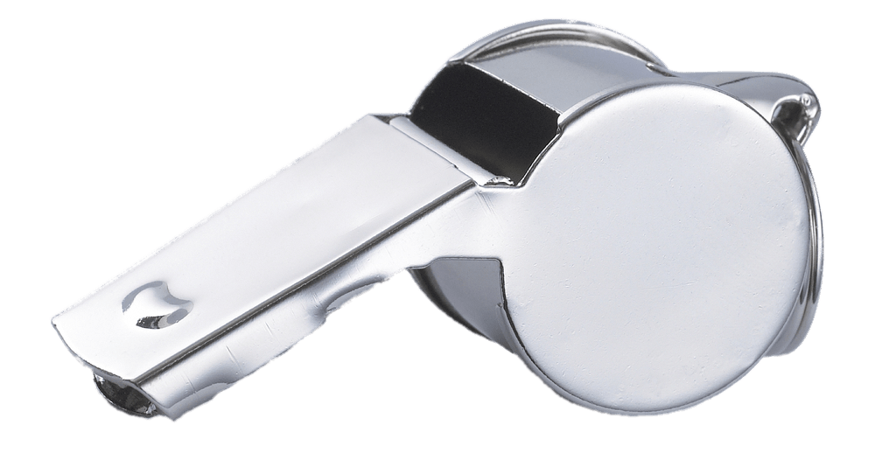
Purrfectly Fabulous Feline Functions
Louise S. Hadden, Abt Associates Inc.
Introduction
Calling the CATs
CALL CATS();
S
CALL CATS, CALL CATT and CALL CATX all behave more or less like their corresponding functions described above, except that the resulting character variable is included in the CALL.
Enhancements:
Arguments can be numeric instead of character; numerics are converted to character using BESTw. Format.
Results can be character or numeric.
The result variable should be initialized by setting length before invocation of the CAT CALL, and the length should be long enough to accommodate the result.
SAS Log:
138 data temp8;
139 length fullname $ 40;
140 set dd.sub2003asm ;
141 call cats(fullname,aa1a,aa1b,aa1c);
142 run;
Cat Functions
Calling Cats
CALL CATT();
Examples
T
SAS Log:
195 data temp11;
196 length fullname $ 40;
197 set dd.sub2003asm (rename=(aa1a=var1
aa1b=var2 aa1c=var3)) ;
198 call catt(fullname,of var1-var3);
199 run;
Litter Box
Conclusion
data temp;
length fullname1 fullname2 fullname3 $ 40;
set dd.sub2003asm ;
call cats(fullname1,aa1a,aa1b,aa1c);
call catt(fullname2,of var1-var3);
call catx(" ",fullname,aa1a,aa1b,aa1c);
run;
Results:
Fullname1 Fullname2 Fullname3
ERMAFLETCHER ERMAFLETCHER ERMA FLETCHER
CALL CATX();
Click Headings Above to View Content
X
SAS Log:
238 data temp14;
239 length fullname $ 40;
240 set dd.sub2003asm ;
241 call catx(" ",fullname,aa1a,aa1b,aa1c);
242 run;
SAS and all other SAS Institute Inc. product or service names are registered trademarks or trademarks of SAS Institute Inc. in the USA and other countries. ® indicates USA registration. Other brand and product names are trademarks of their respective companies.

Slide 4
Purrfectly Fabulous Feline Functions
Louise S. Hadden, Abt Associates Inc.
Introduction
Example 1
Example 3
Click to see Example 3 code snippet
1
3
Cat Functions
Search for characters in numeric variables:
Find specific diagnosis codes
data dxplus;
set dx;
array prx(3) diag1-diag3;
do _n_ = 1 to 3 until (tag eq 1);
tag = (cat(prx(_n_)) in : ('171' '172'));
end;
run;
Create a paragraph to print in a report:
Using a length statement and the CATT function
S
S
Calling Cats
Examples
Litter Box
Example 2
2
Search for diagnoses in different dx fields:
Using the FIND and CATX functions
data cat_find_repeat;
set temp;
dia = (find(catx('*','*',adx, pdx,of odx:),'*250') gt 0);
ast = (find(catx('*','*',adx, pdx,of odx:),'*493') gt 0);
ami = (find(catx('*','*',adx, pdx,of odx:),'*410') gt 0);
brc = (find(catx('*','*',adx, pdx,of odx:),'*174') gt 0);
flu = (find(catx('*','*',adx, pdx,of odx:),'*487') gt 0);
run;
Conclusion
Click Headings Above to View Content
SAS and all other SAS Institute Inc. product or service names are registered trademarks or trademarks of SAS Institute Inc. in the USA and other countries. ® indicates USA registration. Other brand and product names are trademarks of their respective companies.

Slide 5
Purrfectly Fabulous Feline Functions
Louise S. Hadden, Abt Associates Inc.
From the Litter Box – CAveaTs, CATastrophes and CAlamiTies
Introduction
The DEFAULT length of results when using the CAT FUNCTIONS is USUALLY, but not always, 200! Processing speed and efficiency are improved when using a length statement. Make sure to accommodate any extra characters being inserted. The lesson here is to always initialize your variables with an attrib or length statement (shown below), PROC SQL SELECT AS statement, ARRAY statement, etc.!
Failure to use a length statement when using the CAT FUNCTIONS can have unpredictable results, depending on your operating environment and whether or not a temporary buffer is used for the resulting string. If a temporary buffer is used, you may end up with a truncated result. If the function maps directly to the result variable with an inadequate length, you will get a blank result, a warning and note, and the data step error code is set to 1.
If a length of a result variable is too short for CAT CALLS, the result variables are never set to blank. Instead, a truncated result occurs, with a warning, note, and data step error code set to 1.
Depending on where CAT functions are utilized, the maximum length of a result can vary.
If used in a WHERE clauses or with PROC SQL, the maximum length is 200.
If used in a DATA STEP, the maximum length is 32,767.
If called from the macro processor, the maximum length is 65,534.
Results for CAT functions and CAT CALLs are always character, and should not be reserved SAS variables. Items to be concatenated can be character or numeric. If an input item is numeric, it is converted to BESTw. format automatically and leading/trailing blanks are omitted.
If an input item is blank and a delimited is specified, CAT functions and CAT CALLs remove the delimiter for the blank variable.
Cat Functions
Calling Cats
Examples
ATTRIB: BEFORE variable creation and after the SET STATEMENT
ATTRIB
FIPScty length=$3 label='FIPS County Code'
County_name length=$50 label='County Name'
CBSA_code length=$5 label='CBSA Code'
CMS_region length=3 label='CMS Region'
Urban length=3 label='Urban/Rural Flag 1=Urban 0=Rural'
PTHRDMINS label= 'PT staffing (min/resident/day)';
LENGTH: BEFORE variable creation and before the SET STATEMENT
data buildsamp;
length samptype $ 80;
set provider_preview;
if sff=1 then samptype=catx('_',samptype,'SFF');
run;
Litter Box
Conclusion
Click Headings Above to View Content
SAS and all other SAS Institute Inc. product or service names are registered trademarks or trademarks of SAS Institute Inc. in the USA and other countries. ® indicates USA registration. Other brand and product names are trademarks of their respective companies.

Slide 6
Purrfectly Fabulous Feline Functions
Louise S. Hadden, Abt Associates Inc.
Introduction
Conclusion
References
Use of the fabulous feline functions and call routines saves time in both coding and in processing. While results of using the combination method, CAT functions and CAT CALL routines are similar, the feline functions and call routines use less code and process concatenations faster. It is purrfectly clear that the CAT functions and call routines are valuable additions to the SAS® programmer’s toolbox. Try them out, and you’ll be become a CAT lover too!
Cody, Ron. 2004. SAS® Functions by Example. Cary, NC: SAS Institute Inc.
Zdeb, Mike. NESUG 2009. “Searching for Variable Values with CAT Functions: An Alternative to Arrays and Loops” http://www.nesug.org/Proceedings/nesug09/ff/ff04.pdf
Horstman, Joshua. 2013. “Let the CAT Out of the Bag: String Concatenation in SAS”
http://www.mwsug.org/proceedings/2013/S1/MWSUG-2013-S108.pdf
Cat Functions
S
Calling Cats
Examples
Litter Box
Conclusion
Contact Information
Acknowledgements
Click Headings Above to View Content
Your comments and questions are valued and encouraged.
Contact the author at:
Louise Hadden
Abt Associates Inc.
10 Fawcett St.
Cambridge, MA 02138
(617) 349-2385 (work)
Email: louise_hadden@abtassoc.c
The author extends her heartfelt gratitude to her “funcy” friends, mentors and colleagues, especially Ron Cody, Art Carpenter, Richann Watson, Mike Zdeb and Josh Horstman.
All images are free to download from www.disney.com. They are from the movies Lady and the Tramp (the famous Si and Am), the Aristocats, and Oliver and Company.
SAS and all other SAS Institute Inc. product or service names are registered trademarks or trademarks of SAS Institute Inc. in the USA and other countries. ® indicates USA registration. Other brand and product names are trademarks of their respective companies.

Slide 7
Purrfectly Fabulous Feline Functions
Creating paragraphs with SAS®
Code Sample
data ratings_footer;
length blurb $ 32000 ;
footer1="^{style [fontstyle=italic fontsize=10pt]The &currmonth. &fileyear. Five-Star ratings provided above will be displayed for}";
footer2="^{style [fontstyle=italic fontsize=10pt] your nursing home on the Nursing Home Compare (NHC) website on &udate..}";
footer3="^{style [fontstyle=italic fontsize=10pt] The Quality Measure (QM) Rating that will be posted is based on MDS 3.0 quality}";
footer4="^{style [fontstyle=italic fontsize=10pt] measures using data from the &qmperiod., and claims-based quality measures using data from &cbperiod..}";
blurb=CATT(of footer1-footer4);
label blurb =" "; /* label with non-printing character */
run;
….
ods pdf file = ".\testfiles\A5set1##a50000&fnum.##&facnode._&provnum._&stype..pdf" style=styles.pearl
notoc author='Abt Associates Inc.' bookmarklist=hide anchor='Table' compress=9;
….
/* reset style */
ods pdf style=styles.noborder startpage=no;
proc report nowd NOHEADER data=ratings_footer
style(report)=[cellpadding=3pt vjust=b]
style(header)=[just=center font_face=Helvetica font_weight=bold font_size=10pt]
style(lines)=[just=left font_face=Helvetica] ;
columns blurb ;
define blurb / style(COLUMN)={just=l font_face=Helvetica font_size=10pt cellwidth=988 }; /* size in twips */
run;
Back to the Beginning
Back to the Examples
SAS and all other SAS Institute Inc. product or service names are registered trademarks or trademarks of SAS Institute Inc. in the USA and other countries. ® indicates USA registration. Other brand and product names are trademarks of their respective companies.

Slide 8
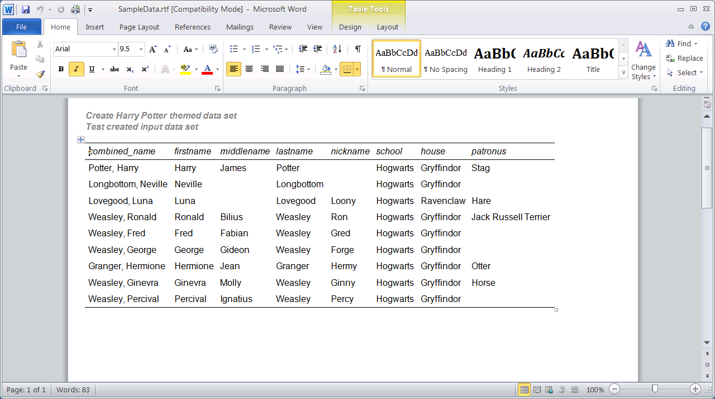
Purrfectly Fabulous Feline Functions
Sample Code and Data Set
Sample DS
Back to the Beginning
Back to CATQ
data temp;
length fullname $ 120; /* set length long enough for final result of CATQ including quotes */
set dd.harrypotter;
fullname=catq('CT',Combined_name,
school,house); /* C=comma delimiter in result, T=remove trailing blanks */
run;
Result of using CATQ function:
fullname
"Potter, Harry",Hogwarts,Gryffindor
SAS and all other SAS Institute Inc. product or service names are registered trademarks or trademarks of SAS Institute Inc. in the USA and other countries. ® indicates USA registration. Other brand and product names are trademarks of their respective companies.

